Slide 1


PaNOSC Kickoff, 16 Jan 2018
Photon and Neutron Open Science Cloud
EGI contribution
to WP6 tasks
Tiziana Ferrari / EGI Foundation

Slide 2
EGI and EUDAT/EOSC-hub collaboration activities
EOSC Service Catalogue Integration
EGI Federated Cloud
EGI Notebooks and Applications on demand
Data Transfer
Data Archiving
Metadata harvesting

Slide 3
T6.2 Overview
Task 6.2 EOSC Hub Service Catalogue (M1-M48). Lead: ESRF, Contributors: all
Activities:
Definition of PaNOSC service and resource provisioning in EOSC
Selection of services and resources, adoption of common service description schema
Definition of application service integration level
Definition of applicable performance metrics, Service Level Agreement management and reporting, accounting and technical support channels

Slide 4
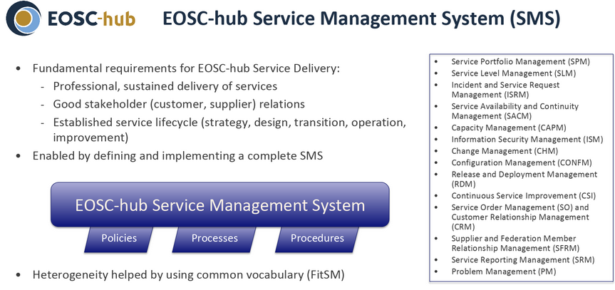
EOSC-hub Service Management System

Slide 5
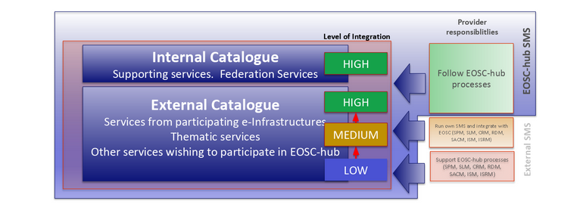
EOSC-hub proposed levels of integration

Slide 6
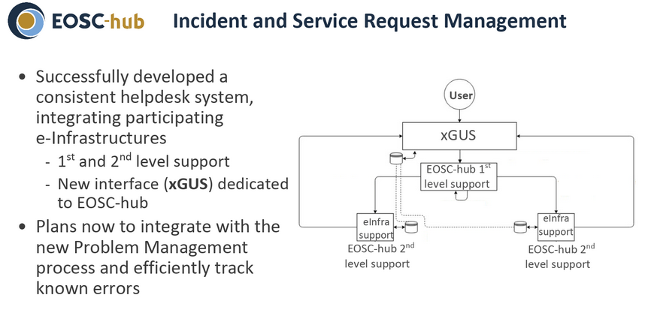
Example of process integration

Slide 7
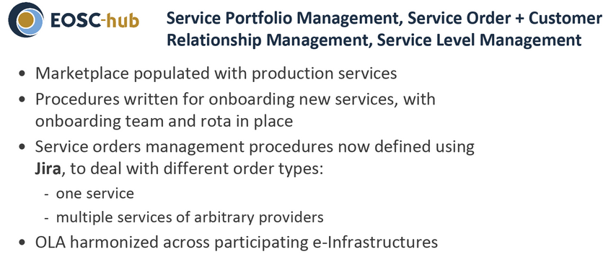
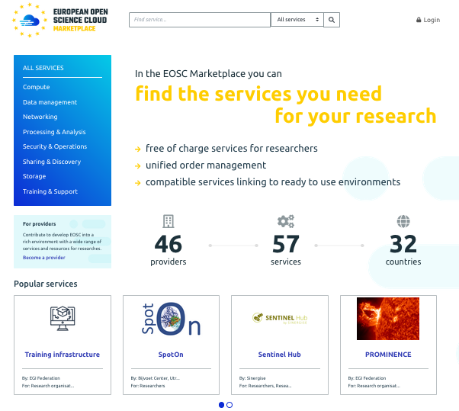
Procedure for registration of services in the marketplace

Slide 8
T6.3 Overview
Task 6.3 Data availability for the services (M1-M48). Lead: ELI
Deliver a combined offer of distributed open data repositories, co-located with cloud compute IaaS and high level applications for data analysis.
Technical challenge: will be to make these federated data transparently accessible by computing resources running on different cloud environments (e-infrastructure, research infrastructures, ...).
For services, where data has to be moved to computers, implement the integration of the EGI data-hub technology into the facility repositories. Test movement of data and understand the limit of such model.
For services where data are too big to be moved, we would like to test the integration of local resources into the EOSC compute cloud.
We also need to evaluate security constraints and necessary measures

Slide 9

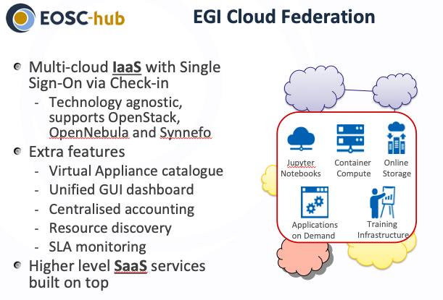
EGI Federated Cloud 1/5

Slide 10
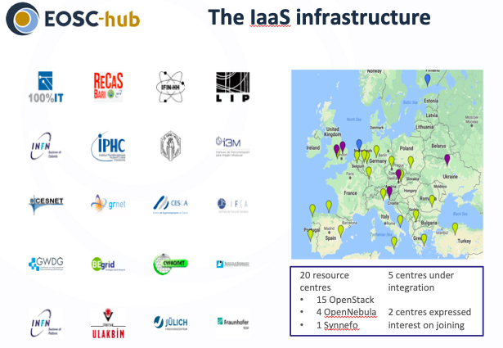
EGI Federated Cloud 2/5

Slide 11
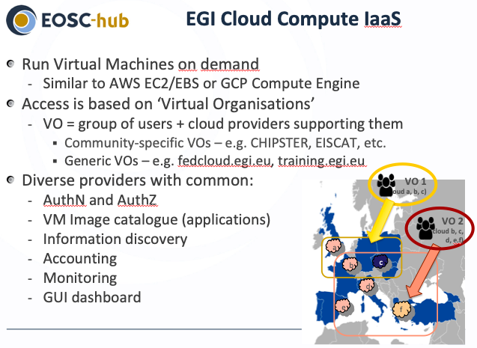
EGI Federated Cloud 3/5

Slide 12
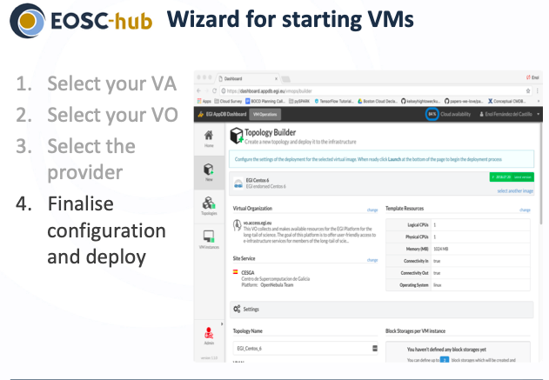
EGI Federated Cloud 4/5

Slide 13
EGI Federated Cloud 5/5
CESNET and DESY are responsible for supporting the increasing PaNOSC computing needs by providing and technically supporting a cloud compute infrastructure offering Cloud compute capacity
DESY will be also responsible for data archiving facility offering 200 TB of storage capacity and for the provisioning o fan online data facility

Slide 14
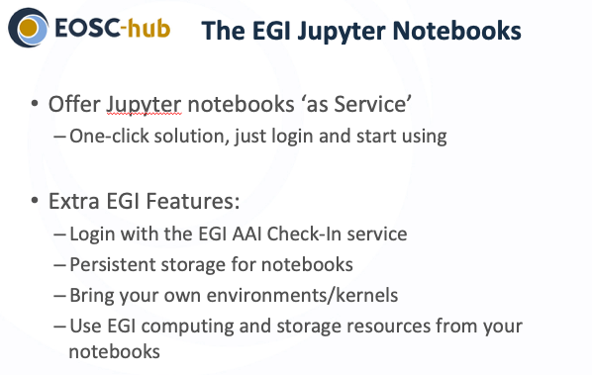
EGI Notebooks 1/2
https://wiki.egi.eu/wiki/EGI_Jupyter

Slide 15
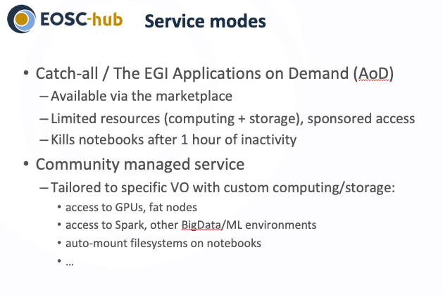
EGI Notebooks 2/2
PaNOSC

Slide 16
EGI Data Transfer
Based on FTS developed at CERN, production service for large scale data transfer, successfully deployed in the WLCG distributed data management infrastructure for data distribution (https://www.egi.eu/services/data-transfer/)
Documentation: https://fts.web.cern.ch/ http://fts3-docs.web.cern.ch/fts3-docs/
STFC will be responsible for providing expertise and services to support the data transfer needs of the Research Infrastructures. The FTS3 data transfer service will be operated and supported leveraging the EGI Helpdesk for incident management.
The provisioning and support of data transfer includes Alpha/Beta testing, requirements analysis, piloting, porting of existing applications to FTS3, and FTS3 operations
STFC will be also responsible of configuring, operating and supporting a data storage facility based on the B2SAFE service offering 4 PB space.

Slide 17
Photon and Neutron Open Science Cloud
Thank your for your attention.

